Slide 1

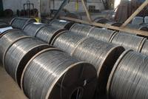


EMF Strategy and the role of EWC’S in the fight against precariuous employment
Internationaler EBR-Workshop vom 16. bis 19. Mai 2010:
IG Metall - Bildungszentrum Sprockhövel
Ralf Götz

Slide 2
Content
What is the EMF?
Collective Bargaining at the EMF
What is a common demand?
1st Common Demand
2nd Common Demand
Outlook

Slide 3
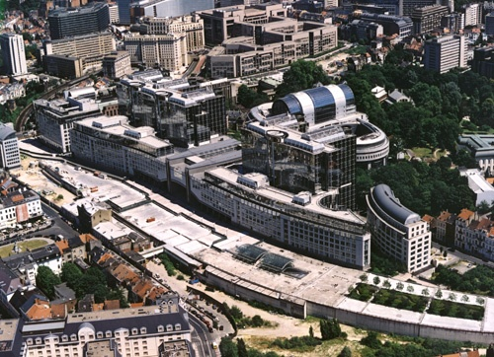
The EMF
European Industry Federation (EIF)
Founded 1971 (Benelux, D, F, I)
73 member organisations in 34 countries: EU 27 + Norway, Switzerland, Turkey, Croatia, Serbia, Kosovo and Bosnia Hercegovina
5,5 million metalworkers
ETUC member

Slide 4
Features of Union Work at European Level
Different trade union structures
Differing Degrees of Organisation
Different Industrial Relations Systems
Different Collective Bargaining Systems
Financial Resources and Size of Staff
Different Languages

Slide 5
Main goals
Cooperation between affiliates – Developing Common Positions and Common Policies
Interest Representation vis-à-vis European Institutions
Counterweight vis-à-vis European employers’ organisations and multinational companies

Slide 6
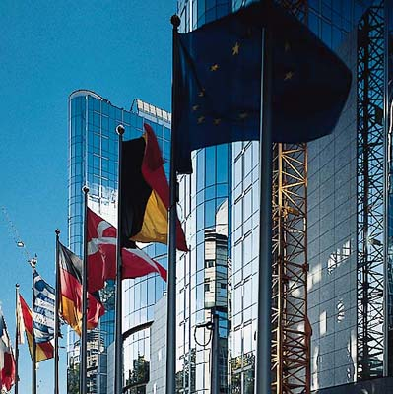
Main areas of work
Industrial Policy
Collective Bargaining
Company Policy (EWCs, SE etc.)
Social Dialogue

Slide 7
EMF Structure
Congress
Executive Committee
Steering Committee
Secretariat
Collective Bargaining
Policy Committee
Company Policy
Committee
Industrial Policy
Committee
Mechanical engineering
Non-ferrous (A)
Training and Education WP
Automobile
Eastern Europe WP
Foundries (A)
Aerospace
Equal Opportunities Committee
Shipbuilding
White goods (A)
Youth Issues
ICT
Social Dialogue
Steel

Slide 8
Collective Bargaining: Towards more Coordination
Single Market
Europeanization of the Economy
Economic Situation
Signal to Employers

Slide 9

Collective Bargaining: Towards more Coordination
Coordination of National Collective Bargaining Policies
(Minimum Standards)
Regional Network of Observers
Information Exchange Network (Eucob@n)

Slide 10
Coordination of national collective bargaining policies
Working Time Charter
  Common Demand: 35 hours/week
  Maximum 1750 Hours/year
  Maximum 100 hours Paid Overtime
Flexibility must be negotiated

Slide 11
Coordination of national collective bargaining policies
Wage coordination rule
  prevent wage dumping and a downward spiral in undercutting working conditions
  maintain Purchasing Power + balanced share of productivity gains
  Productivity Increase can be used for Qualitative Aspects

Slide 12
Other CB guidelines 1
Vocational Training Charter
  Individual Right for every Employee
  Annual Plan Approved by Workers and Employees’ Reps
  Costs Supported by Employers
Social Charter
  Minimum guidelines on (early) retirement
  Minimum guidelines on career interruptions
  Minimum guidelines on sickness benefit systems

Slide 13
Other CB guidelines 2
Financial participation / flexible pay systems
  Respect for voluntary nature
  Financial participation wages
  Trade union involvment and control mechanism
Precarious employment
  Opposed to unsecure employment contracts/conditions
  Need to provide job security, social security, …
  Equal opportunities (in and outside companies)

Slide 14
Regional Network of Observers
Networks in relevant regions
Aim: Pro-active Coordination of Collective Policies
Participation in bargaining rounds
Trans-national comparisons
Signal to Employers

Slide 15
Company Policy
Negotiations on European MNC level
Internal Procedure EMF
  Mandate
  Consultation
  Majority decision (2/3 in each country)
  National implementation

Slide 16
First EMF Common Demand
The Individual Right to Training guaranteed by collective agreements
  New important step in coordination strategy > ex ante in stead of ex post coordination
  Important new signal to employers: continue to coordinate our collective bargaining
  Flexible choice list for implementation > integrating national systems and conditions
  Campaign running during 4 year period
  Road maps for implementation

Slide 17
What is a Common Demand?
The Common Demand includes:
  Political goals agreed at European level;
  A method of implementation (“Open Method of Co-ordination“- OMC);
  A timeframe;
  A campaign

Slide 18
Elements of a common demand
First Step:
  An Agreement on the political goals at European level at the EMF Collective Bargaining Policy Conference - after receiving the green light from the Executive Committee
Second Step:
  Translation of the EMF objectives into national implementation policy by the EMF affiliates. The affiliates define the most appropriate implementing measures in a roadmap (SMH Croatia; Metalicy Bulgaria)
Third step:
  Evaluation and Benchmarking

Slide 19
Roadmap
What?
  Out of the choice list, given as examples and not limitative, used in a creative way and adapted to the national systems
How ?
  What actions, what publications, which collective bargaining round, what level of negotiations, etc.
When ?
  Timeframe
Success criteria ?
  What does the trade union regard as a success regarding the Common Demand – Is it the process and/or the results?

Slide 20
Roadmap II
  These roadmaps have to be sent to the EMF Secretariat within a 4-month period after the decision in the Collective Bargaining Conference.
  The EMF Secretariat will produce an EMF Common Demand Calendar to deliver an overview of when, where and how trade unions intend to negotiate the Common Demand in their countries and campaign to support the implementation.
  During the campaign period the EMF will ask the member organisations for yearly updates on their roadmaps.

Slide 21
Second EMF Common Demand

Slide 22
Basics
  The EMF clearly favours open-ended contracts with one employer as the most secure form of contract regulation, as is for instance also foreseen in the ILO conventions. We nevertheless also recognise that precarious work can be found in a wide diversity of cases.
  The EMF and its affiliates therefore decided, in accordance with the Lisbon Congress decision of June 2007, to initiate the second EMF common demand in the coming collective bargaining rounds, on the topic of “for more secure employment - against precarious work”.

Slide 23
Precarious Employment
A “precarious job” or precarious employment in effect means a job with not enough security to secure or maintain an acceptable living standard in society as a whole - hereby creating a sense of instability, a sense of insecurity as regards what the future may hold for you.
Precarious employment is a very wide issue

Slide 24
Signs of precarious jobs
  With little or no job security;
  With low and unsecured wages;
  Without or with insufficient access to social security (concerning pension, health insurance, unemployment payment);
  Without control over the labour process, which is linked to the presence or absence of trade unions and relates to control over working conditions, wages and the pace of work;
  Without any protection against dismissals;
  Without access to vocational training;
  Without career opportunities;
  With little or no health and safety at work;
  Without legal or contractual protection;
  With no trade union representation
  Informal economy/ Registration of workers on minimum wage

Slide 25
TEMPORARY AGENCY WORK
Temporary Agency Work
The first important element for trade unions should be to implement the Directive on Temporary Agency Work in such a way that it guarantees full, equal treatment of temporary agency workers.

Slide 26
Temporary Agency Work
  Specific other elements could include:
  Guaranteeing full access to all existing benefits of the user companies, and this through provisions inside the user companies and/or the agencies;
  Guaranteeing access to and information about all health and safety regulations inside the user company, including access to the same health and safety equipment and training as provided by the user company;
  Guaranteeing the access and the right to individual training;
  Negotiating collective agreements on sector or agency level where other rules and regulations do not provide equal treatment in wages or other provisions;
  Limiting the use of temporary agency work, e.g. providing upper limits on use, providing specific reasons for use (seasonal peaks, peaks of activity, ...), excluding certain sectors;
  Excluding the possibility for employers to use temporary agency work in a user-company on strike.

Slide 27
Fixed-Term Contracts
  Limiting the number of consecutive fixed-term contracts in one company;
  Putting an upper limit on the number of fixed-term contracts in a company;
  Providing full access to all benefits of the company;
  Limiting the reasons for the use of these kind of contracts, e.g. for seasonal work or temporary peaks;
  Guaranteeing a possible transition to an open-ended contract.

Slide 28
Bogus Self-Employed
  Where law, rules and/or agreements do not already provide this, we should negotiate a clear definition of self-employed versus bogus self-employed: “working under supervision” should in all cases be considered as a normal labour contract and not as a self-employed contract;
  To exclude, or limit, the use of bogus self-employed contracts;
  To limit the reason for use of these kind of contracts.

Slide 29
Zero Hour Contracts
  The zero hour contracts are a new development, outside the scope of the traditional on-call work, where the worker is on-call if and when the company need him/her and where the worker is only paid for the hours where he/she is called. In some countries this is referred to as casual work or casual contracts.
  Rejection of all “zero-hour” contracts;
  Provision of clear agreements for the traditional on-call work, defining clearly the way it is paid, the way it is recuperated, the working time aspects .

Slide 30
Part-Time Work
  Part-time work in itself is certainly not to be considered as precarious work!
  As trade unions we should promote the voluntary aspect of part-time work; in many cases our members are interested in doing part-time work;
  Agreements could provide access to part-time work at the demand of the employee: an individual right;
  Part-time jobs should always have full access to social security;
  Guarantee equal access to training facilities and training possibilities;
  Guarantee equal career opportunities for part-time workers;
  Include a possibility to return to a full-time contract.
aaa

Slide 31
Outsourcing /Subcontracting
  Joint responsibility of the co-owners of companies;
  Agreements on equal treatment for wages, working conditions, training and career opportunities for workers in outsourced activities or daughter companies;
  Social standard clauses in the collective agreements of the mother company, providing clear rules for the outsourced companies or subcontractors;
  To include a certain number of minimum regulations and minimum norms for the outsourced or subcontracted activities;
  The need to have a prior agreement of trade unions / works council on possible outsourcing or subcontracting activities;
  To foresee trade union / works council control over the activities of the outsourced or subcontracted activities;
  To foresee the possibility for joint collective agreements for the complete chain of activities;
  To provide a basic code of conduct for subcontractors.

Slide 32
Non-Solicitation Agreement / Non Competition Agreement
  Total prohibition of all non-solicitation agreements;
  Such agreements should at the least be co-signed by the workers in question, otherwise the effects should be invalid;
  A limitation of non-competition clauses in individual labour contracts;
  Maximum limit in time and scope of non-competition clauses.

Slide 33
Job Security for Open-ended Contracts
  To promote open ended contracts as the standard contracts in our industry;
  To provide improvements on dismissals clauses, including for instance the improvement or lengthening of notice periods;
  Provide general job security clauses in collective agreements;
  To provide training as a reinforcement of the career;
  To include internal career opportunities.

Slide 34
To be considered for the future…
Implementation of the common demand on all levels;
Closer interlinking of the EMF policy fields (e.g. topic at the CP-conference 2010);
Use the material, signs, posters, logos and make the European dimension visible;
This is no formality: one of the most important policy goals of the EMF with an active approach

Slide 35
Collective Bargaining:
Future Perspectives
European Framework Agreements
EMF Counterpart
More Common demands?
Architecture of Collective Bargaining
at European Level
Anticipating changes in collective bargaining structures = importance of company level bargaining

Slide 36
Sources
www.emf-fem.org
www.eucoban.eu
www.precariouswork.eu
www.industrialpolicy.eu

